Slide 1


HIPAA Form App
Emaan Syed

Slide 2
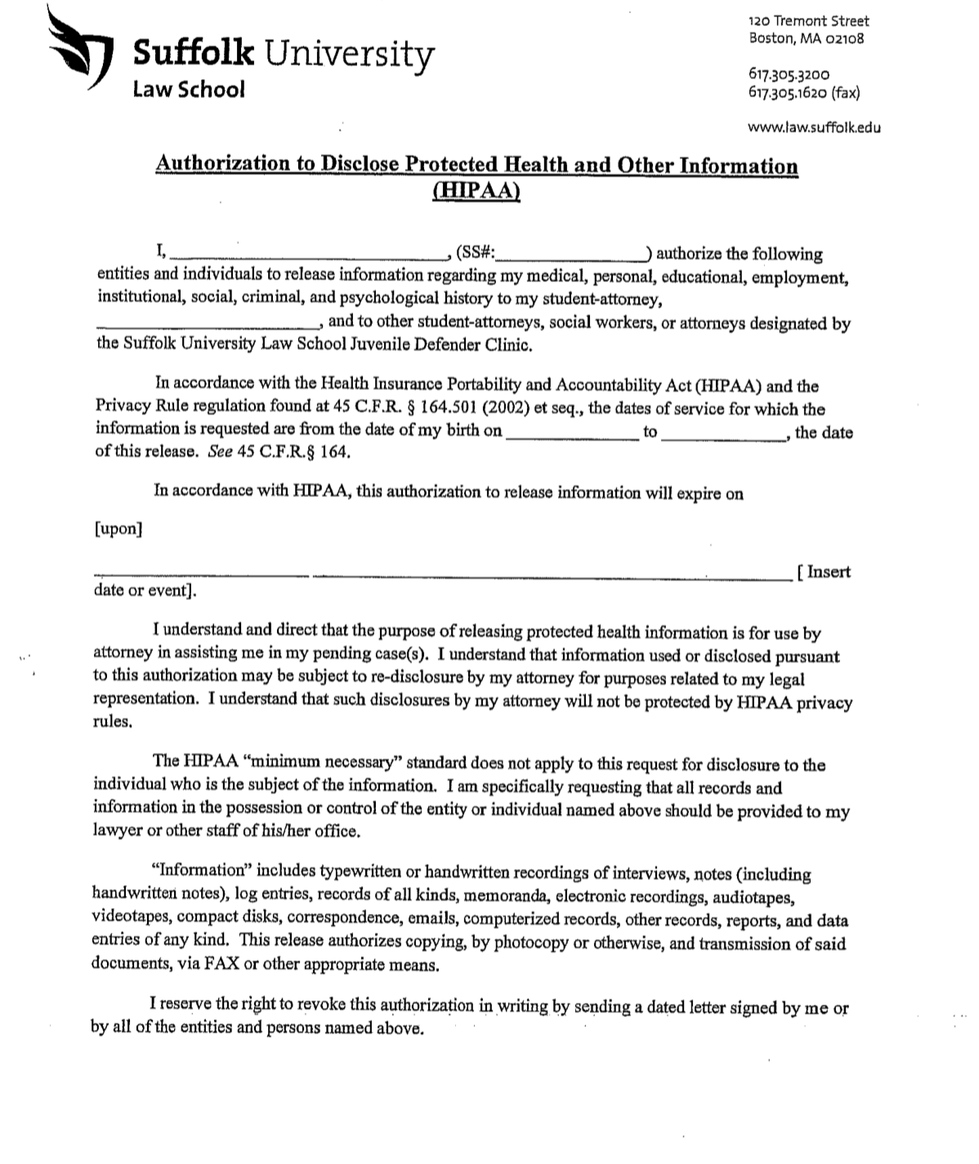
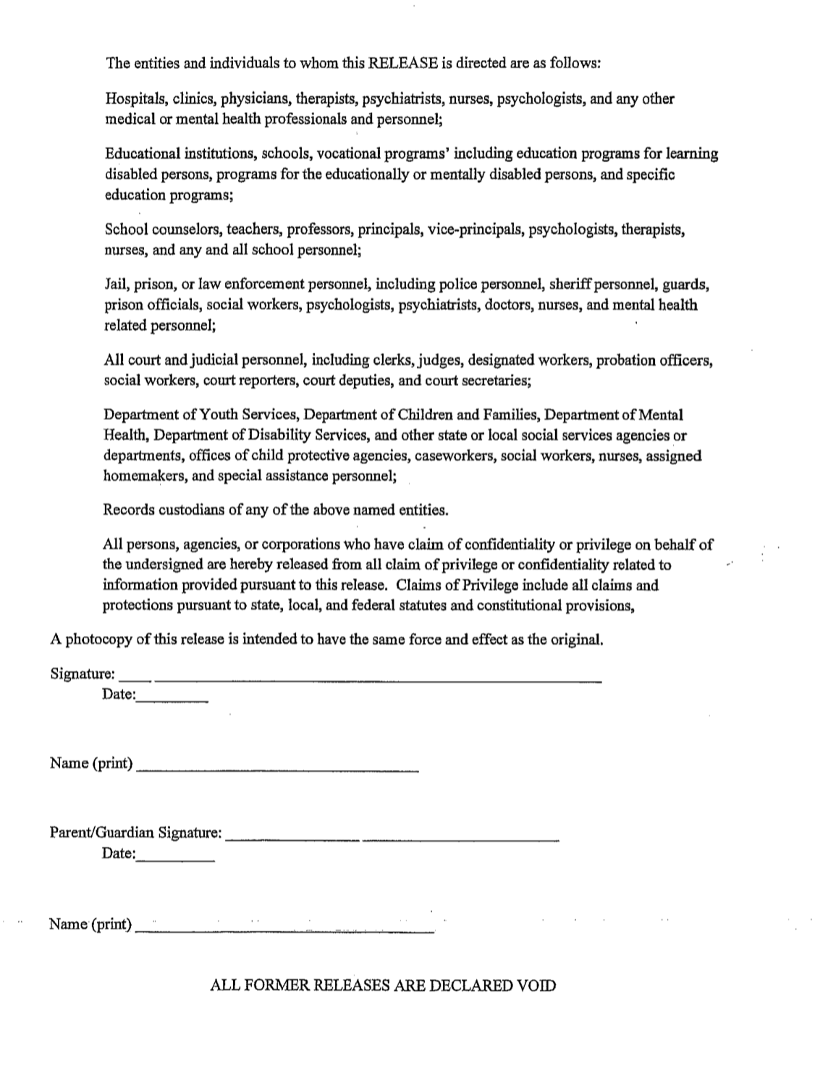

HIPAA FORM

Slide 3
Problems with Current Form
Need to physically carry
Need physical signature
Come back to office to fax or email form
Whole process takes an hour

Slide 4
Creation of App
Will allow faster delivery to hospitals
Include other HIPAA forms from hospitals that have their own
Automated process easier to save and document

Slide 5
Plans for the App
Use Community Lawyer or Doc Assemble to create a user-friendly automated online App or website
Have a signature function
Include other hospitals that do not use Suffolk Clinic HIPAA Form
Get legal clearance from hospitals to automate these forms
Fax form to hospital through app
Send email of form as a PDF

Slide 6
Goals
Create Faster HIPAA form release to hospital for faster client help and care
Use amongst the Suffolk Law clinics and other public defender offices across state and country

